Slide 1
What Is Machine Learning?
Machine Learning is the science (and art) of programming computers so they can learn from data.
Here is a slightly more general definition:
[Machine Learning is the] field of study that gives computers the ability to learn without being explicitly programmed.
By Arthur Samuel, 1959

Slide 2
Why Use Machine Learning?
Consider how you would write a spam filter using traditional programming techniques
1. First you would look at what spam typically looks like. You might notice that some words or phrases (such as “4U,” “credit card,” “free,” and “amazing”) tend to come up a lot in the subject. Perhaps you would also notice a few other patterns in the sender’s name, the email’s body, and so on.
2. You would write a detection algorithm for each of the patterns that you noticed, and your program would flag emails as spam if a number of these patterns are detected.
3. You would test your program, and repeat steps 1 and 2 until it is good enough.
Since the problem is not trivial, your program will likely become a long list of complex rules—pretty hard to maintain.

Slide 3
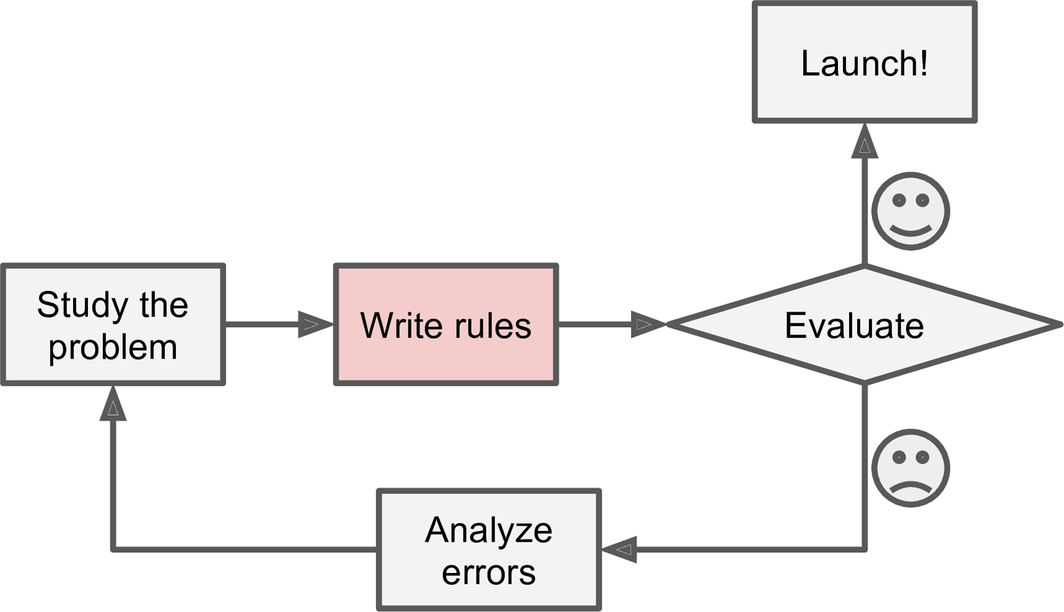
Figure 1-1. The traditional approach

Slide 4
In contrast, a spam filter based on Machine Learning techniques automatically learns which words and phrases are good predictors of spam by detecting unusually frequent patterns of words in the spam examples compared to the ham examples
(Figure 1-2). The program is much shorter, easier to maintain, and most likely more accurate.

Slide 5
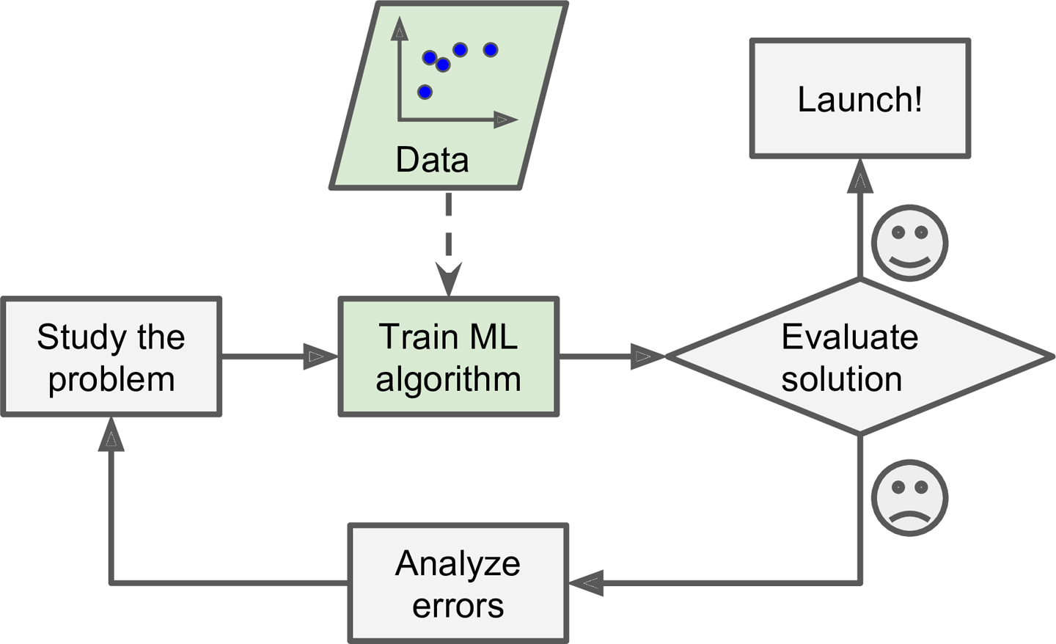
Figure 1-2. Machine Learning approach

Slide 6
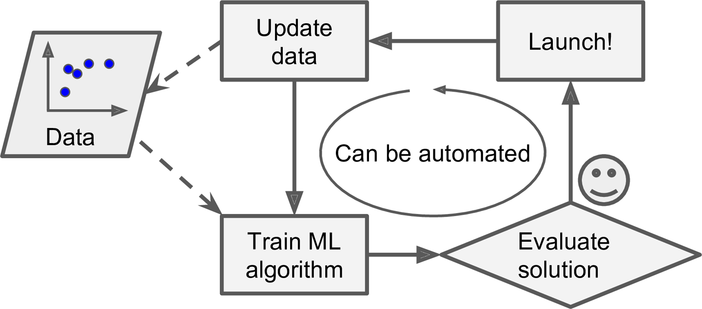
Figure 1-3. Automatically adapting to change

Slide 7
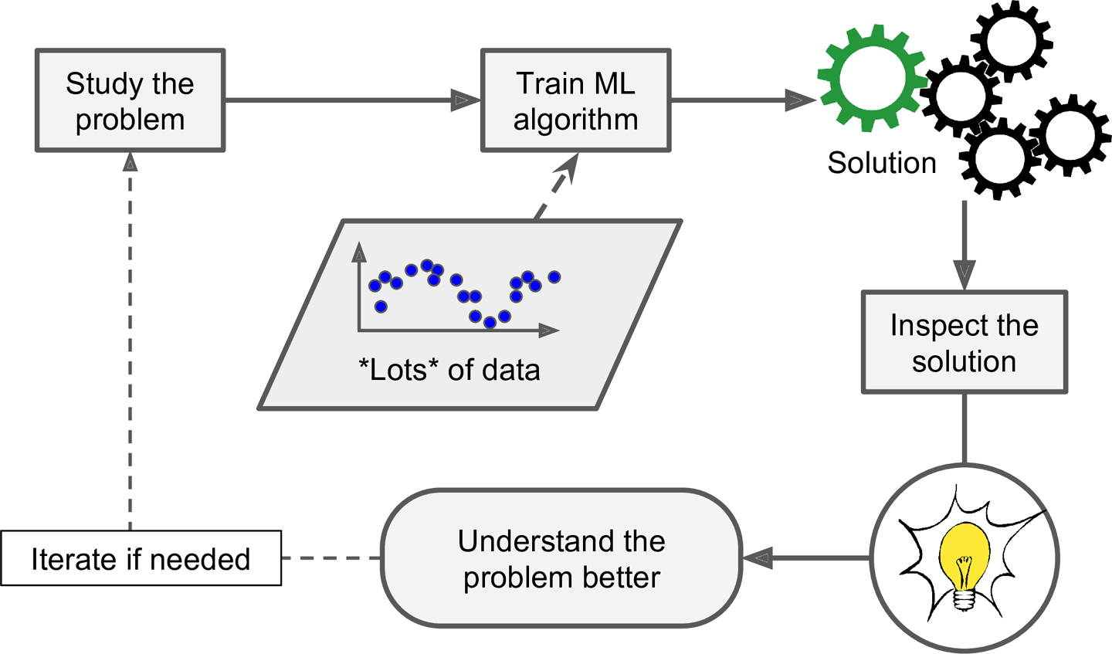
Figure 1-4. Machine Learning can help humans learn

Slide 8
Machine Learning is great for:
1.Problems for which existing solutions require a lot of hand-tuning or long lists of rules: one Machine Learning algorithm can often simplify code and perform better.
2.Complex problems for which there is no good solution at all using a traditional approach: The best Machine Learning techniques can find a solution.
3.Fluctuating environments: A Machine Learning system can adapt to new data.
4. Getting insights about complex problems and large amounts of data.

